Slide 1


Slide 2
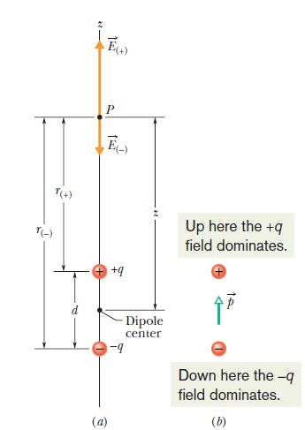
Electric dipole
Two charged particles of magnitude q but of opposite sign, separated by a distance d, this configuration is called an electric dipole

Slide 3
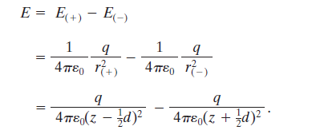
The Electric Field Due to an Electric dipole
By superposition principle for electric fields, we find the magnitude E at P is

Slide 4


The Electric Field Due to an Electric dipole

Slide 5
The Electric Field Due to an Electric dipole
We are usually interested in the electrical effect of a dipole only at distances that are large compared with the dimensions of the dipole—that is, at distances such that z>>d. At such large distances, we have d/2z<<1 . Thus, in our approximation, we can neglect the d/2z term in the denominator, which leaves us with

Slide 6


The Electric Field Due to an Electric dipole

Slide 7

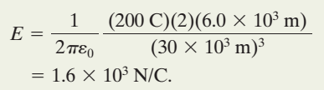

Problem
If q=200 C and h=6.0 km, what is the magnitude of the dipole’s electric field at altitude z₁=30 km somewhat above the clouds and altitude z₂=60 km somewhat above the stratosphere?

Slide 8
